Slide 1
Electrical Circuits Lecture 1: Introduction By: Mahmoud Momtazpour ceit.aut.ac.ir/~momtazpour
Amirkabir University of Technology

Slide 2
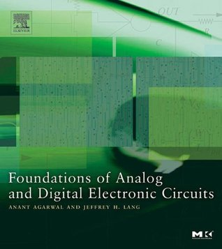
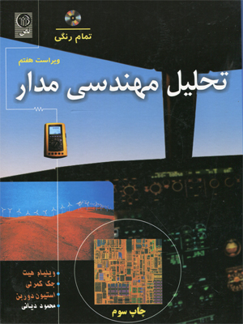
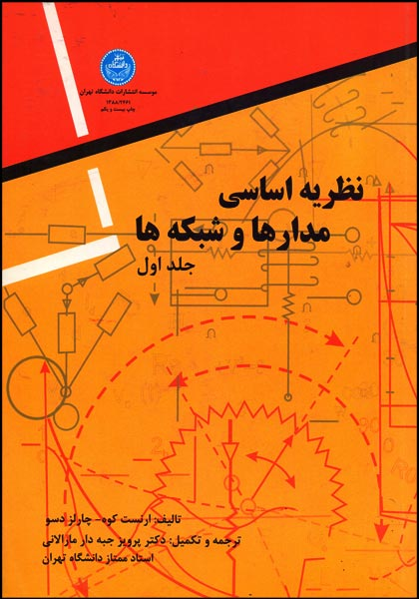
Textbook
C. Desoer, Basic Circuit Theory, 2nd Edition
W. Hayt, Engineering Circuit Analysis, 8th Edition
A. Agarwal, Foundations of Analog and Digital Electronic Circuits

Slide 3
SI: Units and Prefixes
Any measurement can be expressed in terms
of a unit, or a unit with a “prefix” modifier.
Example: 12.3 mW = 0.0123 W =1.23 x 10⁻² W
FACTOR | NAME | SYMBOL
10⁻⁹ | nano | n
10⁻⁶ | micro | μ
10⁻³ | milli | m
10³ | kilo | k
10⁶ | mega | M
Notes:
SI: International system of units: سیستم واحد گذاری بین المللی
یک استاندارد برای اندازه گیری جرم، حجم، طول و ...

Slide 4
Charge
charge is conserved: it is neither created nor destroyed
symbol: Q or q; units are coulomb (C)
the smallest charge, the electronic charge, is carried by an electron (−1.602×10⁻¹⁹ C) or a proton (+1.602×10⁻¹⁹ C)
in most circuits, the charges in motion are electrons

Slide 5
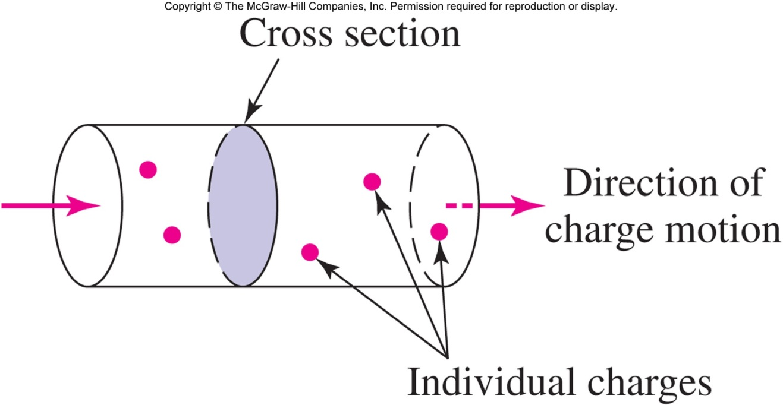
Current and Charge
Current is the rate of charge flow:
1 ampere = 1 coulomb/second (or 1 A = 1 C/s)

Slide 6
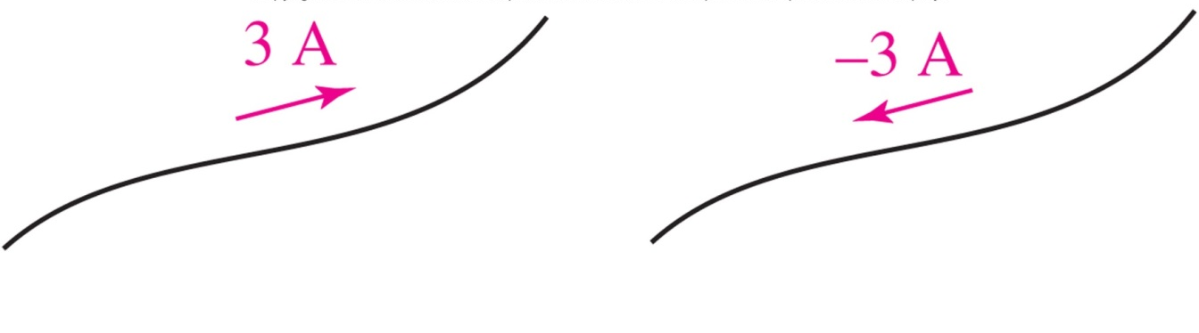
Current and Charge
Current (designated by I or i) is the rate of flow of charge
i=dq/dt
Current must be designated with both a direction and a magnitude
These two currents are the same:

Slide 7
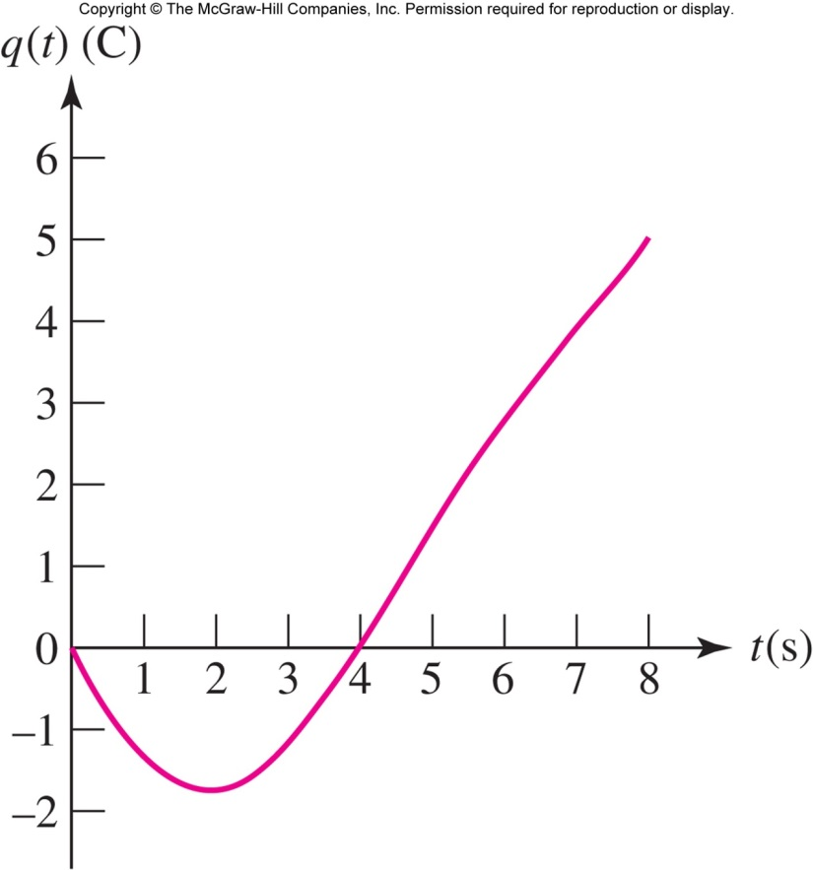
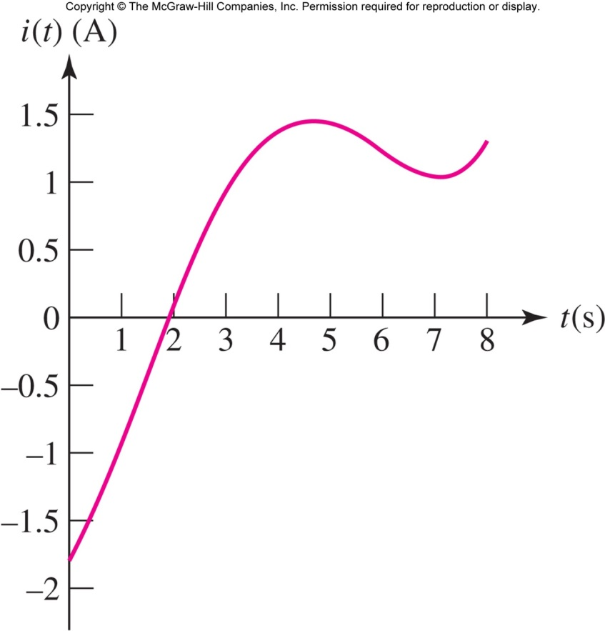
Current and Charge: i=dq/dt
Notes:
بار در ثانیه 4 صفر است، ولی جریان 1.5. معنی آن چیست؟

Slide 8
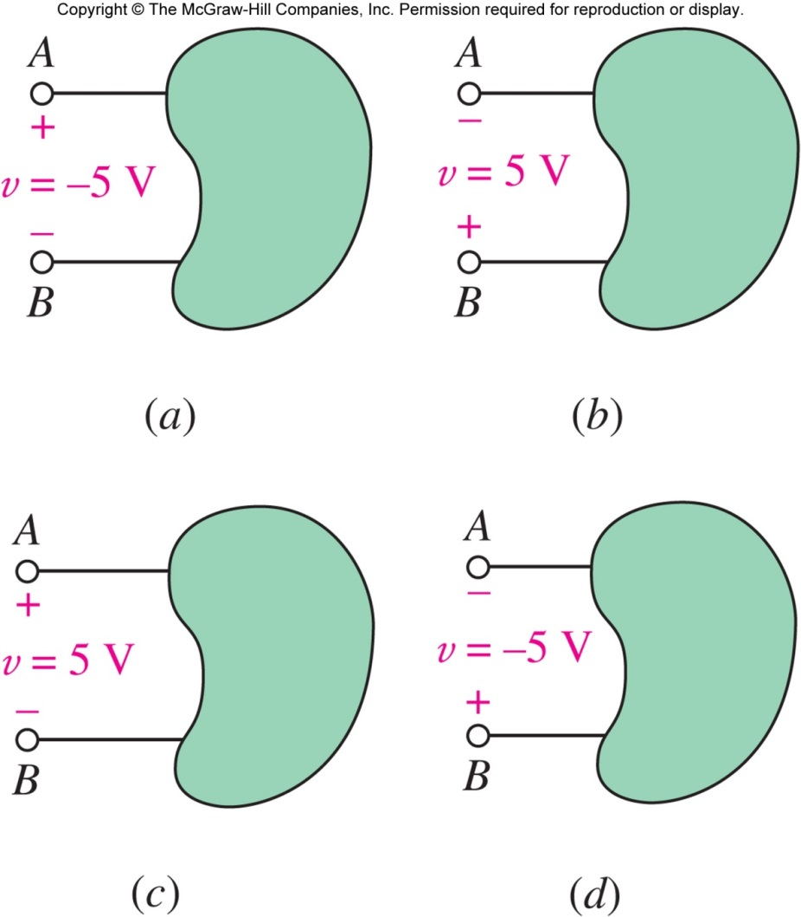
Voltage
When 1 J of work is required to move 1 C of charge from A to B, there is a voltage of 1 volt between A and B.
V = dW/dq
Voltage (V or v) across an element requires both a magnitude and a polarity.
Example: (a)=(b), (c)=(d)

Slide 9
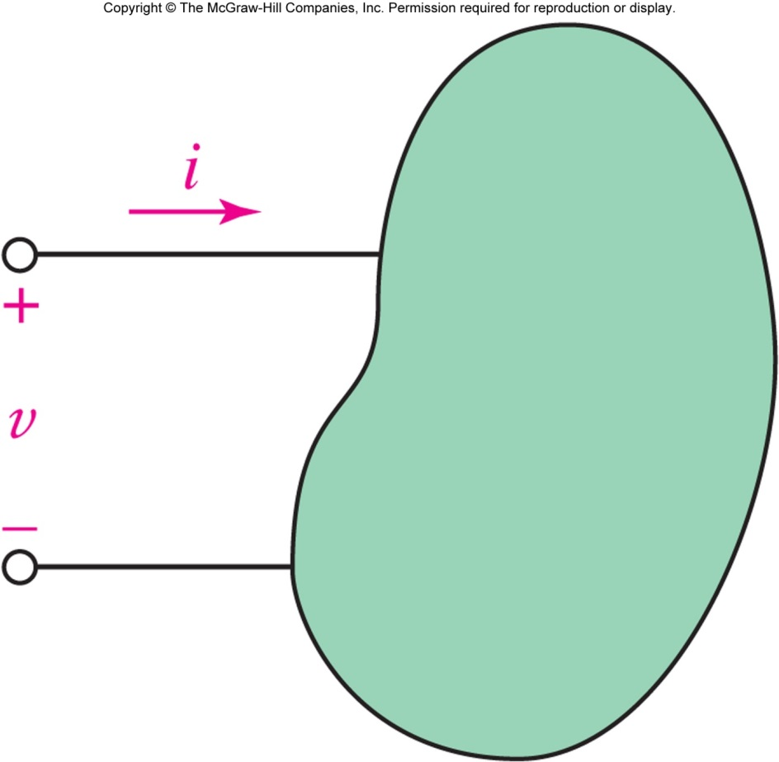
Power: p = v i
The power required to push a current i (C/s) into a voltage v (J/C) is p = vi ( J/s = W).
When power is positive, the element is absorbing energy.
(Passive element)
When power is negative, the element is supplying energy.
(Active element)

Slide 10
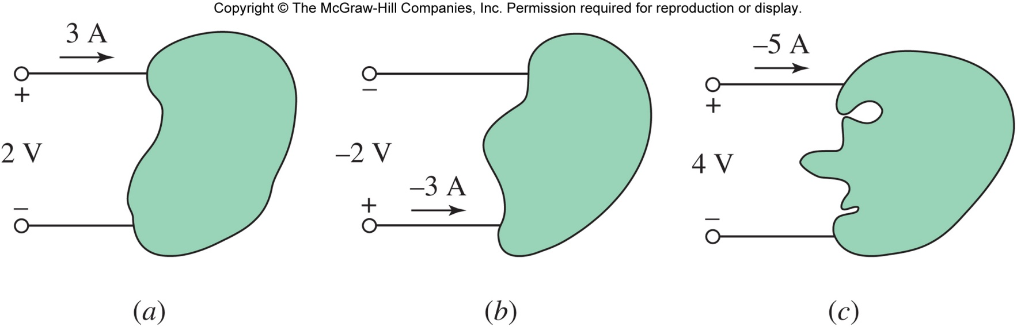
Example: Power
How much power is absorbed by the three elements above?
P_{a} = + 6 W, P_{b} = +6 W, P_{c} = -20 W.
(Note: (c) is actually supplying power)
Notes:
جهت قراردادی با ارائه یک مثال از سه دانشجو که جهتهای متفاوتی می گیرند و تاثیر آن بر محاسبه توان مصرفی یا تولیدی

Slide 11

Circuit Elements
A circuit element usually has two terminals (sometimes three or more).
The relationship between the voltage v across the terminals and the current i through the device defines the circuit element model.

Slide 12
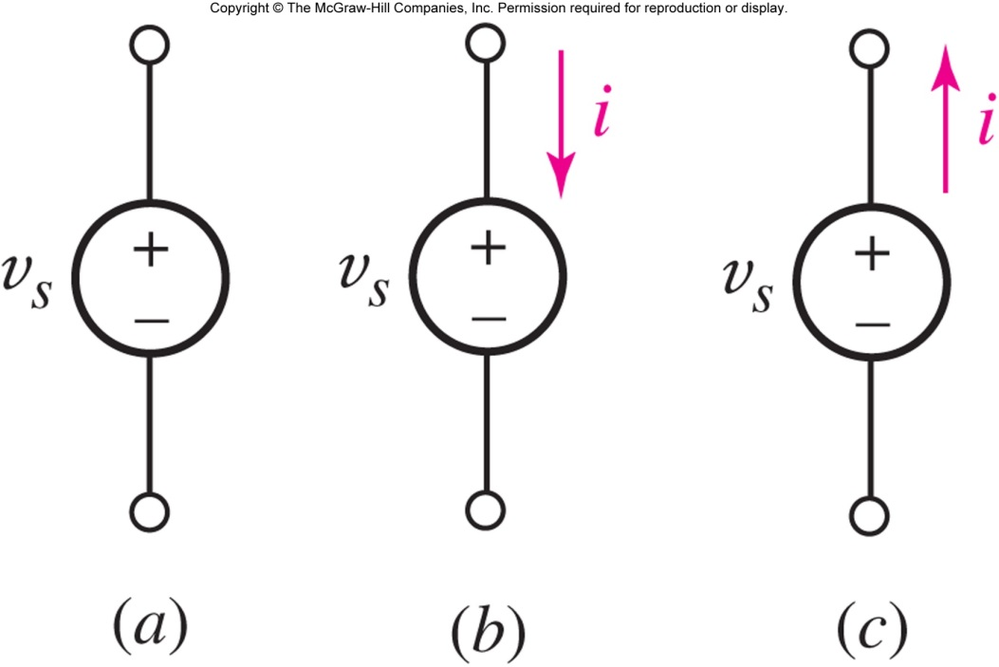
Voltage Sources
An ideal voltage source is a circuit element that will maintain the specified voltage v_{s} across its terminals.
The current will be determined by other circuit elements.

Slide 13
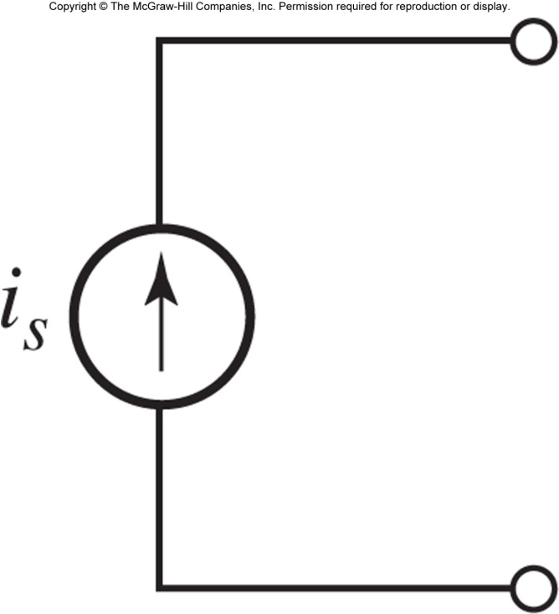
Current Sources
An ideal current source is a circuit element that maintains the specified current flow i_{s} through its terminals.
The voltage is determined by other circuit elements.

Slide 14
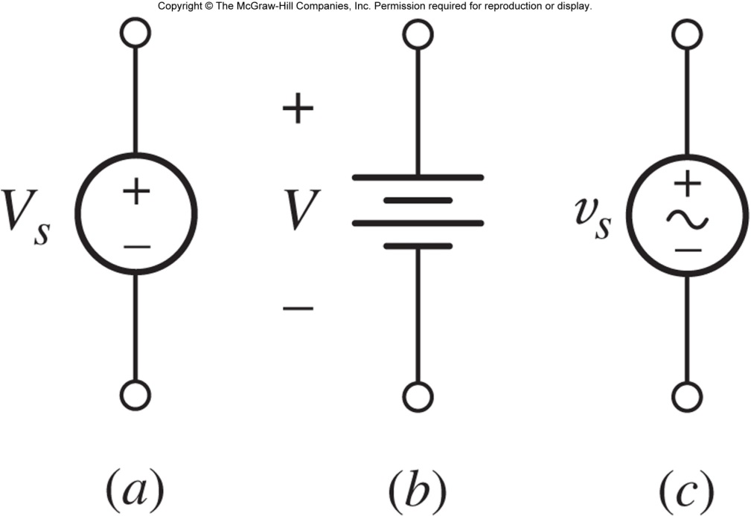
Battery as a Voltage Source
A voltage source is an idealization (no limit on current) and generalization (voltage can be time-varying) of a battery.
A battery supplies a constant “dc” voltage V but in practice a battery has a maximum power.

Slide 15
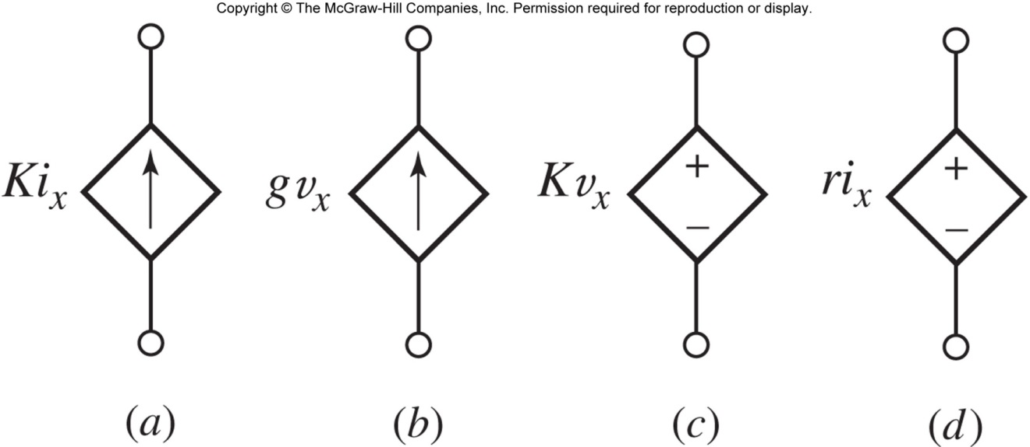
Dependent Sources
Dependent current sources (a) and (b) maintain a current specified by another circuit variable.
Dependent voltage sources (c) and (d) maintain a voltage specified by another circuit variable.

Slide 16
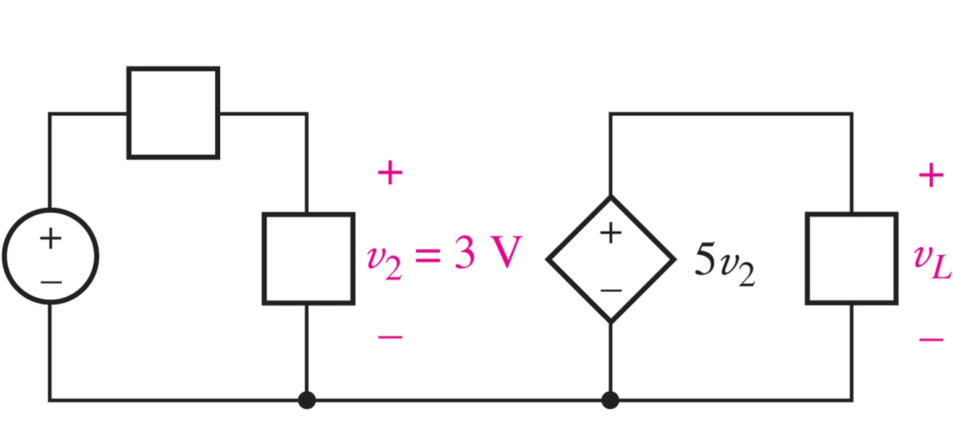
Example: Dependent Sources
Find the voltage v_{L} in the circuit below.

Slide 17
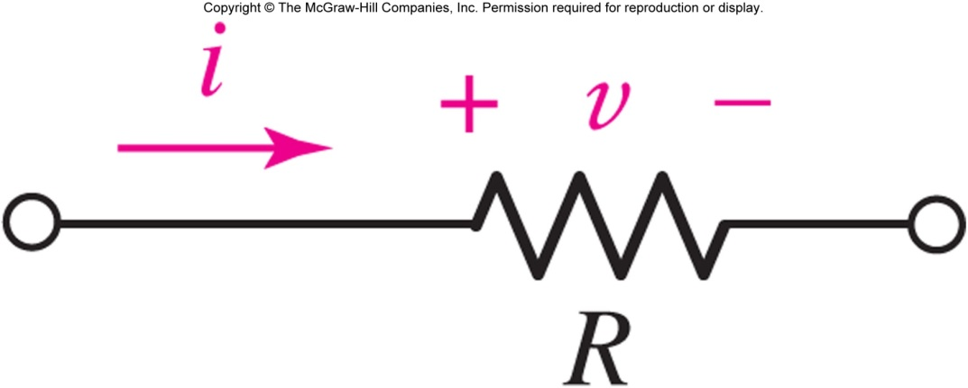
Ohm’s Law: Resistance
A (linear) resistor is an element for which
v=Ri
where the constant R is a resistance.
The equation is known as “Ohm’s Law.”
The unit of resistance is ohm (Ω).

Slide 18
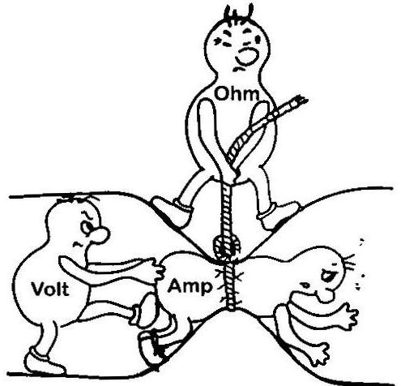
Ohm Law Visualization

Slide 19
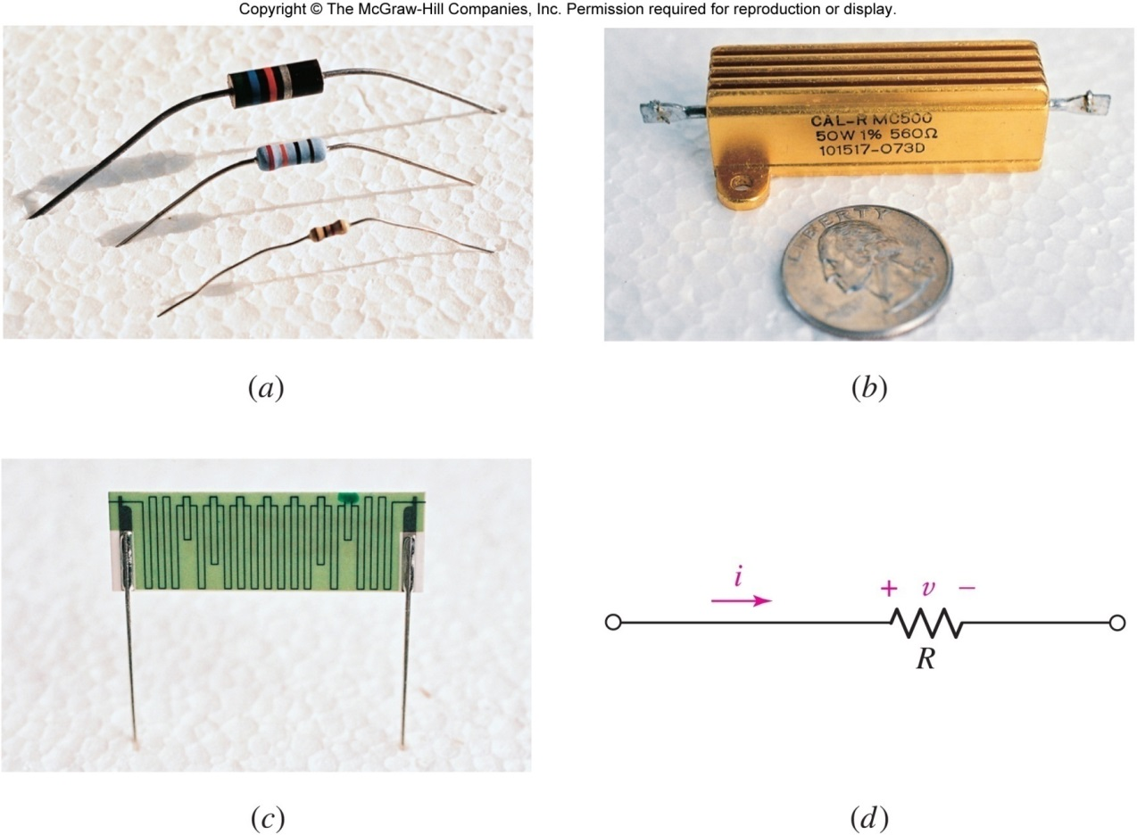
Resistors
typical resistors (b) power resistor
(c) a 10 TΩ resistor (d) circuit symbol

Slide 20
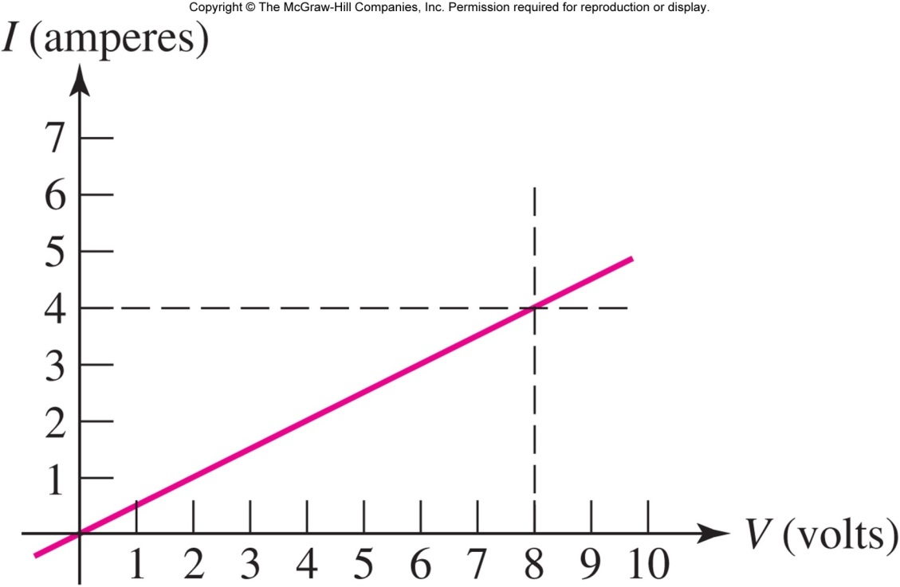
The i-v Graph for a Resistor
For a resistor, the plot of current versus voltage is a straight line:
R=?
In this example, the slope is 4 A / 8 V or 0.5 Ω^{-1.}
This is the graph for a 2 ohm resistor.

Slide 21

Power Absorption
Resistors absorb power: since v=iR
p=vi = v²/R = i²R
Positive power means the device is absorbing energy.
Power is always positive for a resistor!
Notes:
المانهای پسیو (غیر فعال) مانند سیم، مقاومت و دیود خطی و ... نمی توانند مقاومت مطلق (R=v/i) منفی داشته باشند. برای داشتن مقاومت منفی، المان باید اکتیو باشد مانند منبع تغذیه و باتری، که در مورد آنها واژه مقاومت خیلی کاربردی نیست و عملا استفاده نمی شود.
جالب است بدانید که مفهومی به نام مقاومت تفاضلی نیز وجود دارد که به صورت R=dv/di تعریف می شود. در برخی المانهای غیرخطی مانند تقویت کننده ها و لامپ خلاء و برخی انواع دیودهای غیر خطی، مقدار این مقاومت می تواند منفی باشد.

Slide 22
Example: Resistor Power
A 560 Ω resistor is connected to a circuit which causes a current of 42.4 mA to flow through it.
Calculate the voltage across the resistor and the power it is dissipating.
v = iR = (0.0424)(560) = 23.7 V
p = i ²R = (0.0424)²(560) = 1.007 W

Slide 23
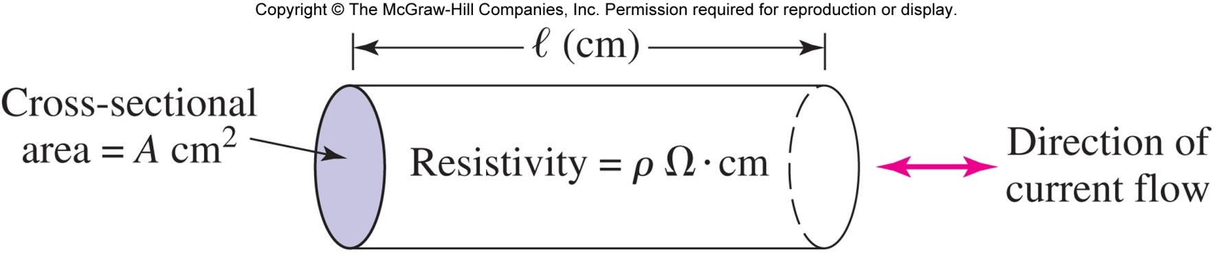
Wire Gauge and Resistivity
The resistance of a wire is determined by the resistivity of the conductor as well as the geometry:
R = ρ l / A
[In most cases, the resistance of wires can be assumed to be 0 ohms.]

Slide 24
Conductance
We sometimes prefer to work with the reciprocal of resistance (1/R), which is called conductance (symbol G, unit siemens (S)).
A resistor R has conductance G=1/R.
The i-v equation (i.e. Ohm’s law) can be written as
i=Gv
Notes:
رسانایی یا کانداکتنس، معکوس مقاومت است و نشان می دهد یک المان چقدر هادی خوبی برای جریان است.

Slide 25
Open and Short Circuits
An open circuit between A and B means i=0.
Voltage across an open circuit: any value.
An open circuit is equivalent to R = ∞ Ω.
A short circuit between A and B means v=0.
Current through a short circuit: any value.
A short circuit is equivalent to R = 0 Ω.

Slide 26
Circuit Component
Circuit Components
Linear
Time-Variant
Time-Invariant
Nonlinear
Time-Variant
Time-Invariant

Slide 27
Linear vs. Nonlinear
f(x) is linear iff:
f(x1+x2)=f(x1)+f(x2)
f(ax)=af(x)
Linear resistor
v = f(i) = 2 i
Nonlinear resistor
v = f(i) = 50 i + 0.5 i³
E.g. Diodes, Neon Lamps
Nonlinear
Linear

Slide 28
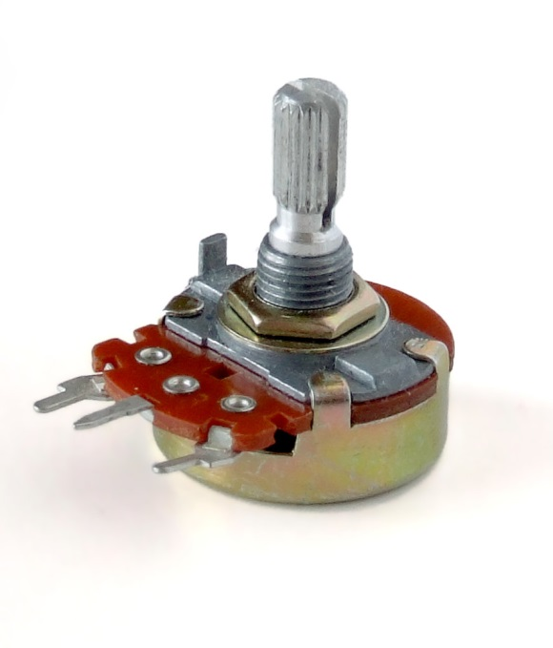
Time-variant vs. Time-Invariant
Example:
Time-invariant resistor
v(t) = R i(t) , R = constant
Time-variant resistor
v(t) = R(t) i(t), R(t) = R_{a} + R_{b}cos2𝜋ft
E.g. Potentiometer

Slide 29
Summary
Electrical circuits concepts
Charge, Current, Voltage, Power, Energy
Voltage/Current Sources
Resistor as the simplest element of Elec. Circuits
V=RI
G=1/R
P=VI=RI²
Active vs. Passive elements
Linear/Nonlinear, Time Variant/Invariant

Slide 30
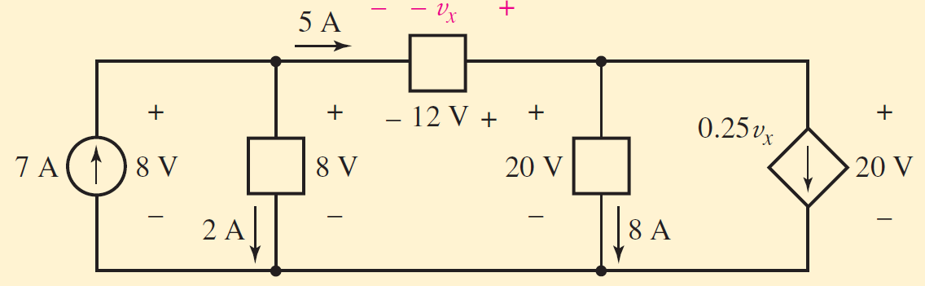
In-class Exercise
Find the power absorbed by each element in the circuit
(left to right) −56 W; 16 W; −60 W; 160 W; −60 W.

Slide 31
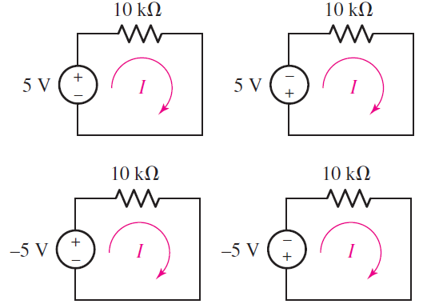
In-class Exercise 2
Compute I and P_{R} for each figure

Slide 32
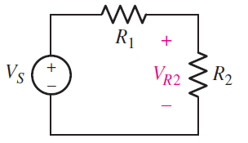
In-class Exercise 2
Compute V_{R2} as a function of V_{S}, R₁ and R₂.

